Slide 1


ABET’s Approach to Continuous Improvement and Student Outcome Attainment
Scott Danielson, , Ph.D., Professional Engineer, Fellow of ASME, Fellow of ABET
Vietnam Education Quality Management Agency (VQA)
Conference for
Training on Education Quality Assurance and Accreditation for Vietnamese Higher Education Institutions
Host: Vietnam Education Quality Management Agency (VQA)
26 November 2024
© Scott Danielson

Slide 2

Presenter
Dr. Scott Danielson, P.E.
Fellow of ASME
Fellow of ABET
Emeritus Associate Professor
Ira A Fulton Schools of Engineering, Arizona State University
My thanks to Dr. Huỳnh Văn Chương, Director of VQA, MOET, and Dr. Trần Bích Huệ, Division Head of Quality Accreditation Management of VQA for inviting me to speak today.
© Scott Danielson

Slide 3
Scott Danielson
Experience with ABET
Began ABET volunteer work in 2003
Assessor (program evaluator) for 17 program evaluations for both EAC and ETAC (2 evaluations in fall of 2024)
Currently the ABET Bridge Advising Coordinator and advisor (consultant)
Lead assessor (team chair) for over 17 evaluations
Editor (reviewer of institution’s accreditation statement) for over 100 evaluations
Past Chair of the Engineering Technology Area Delegation and ABET Board of Directors member
Past Chair of the Engineering Technology Accreditation Commission
© Scott Danielson

Slide 4
ABET’s Global Presence**
ABET is headquartered in Baltimore, Maryland (United States) and the majority of its programs are in the USA.
But, ABET has a global presence.
Programs and institutions having received ABET accreditation currently number 4,773 programs at 930 colleges and universities in 42 countries, including Vietnam.
**Data are from the ABET website on 1 November 2024
Adapted from https://www.abet.org
© Scott Danielson

Slide 5
ABET in Vietnam
The first programs in Vietnam to be accredited by ABET were at a prestigious national university in 2011. They did this without ASU support at a cost of $500,000 US.
The next 2 programs accredited by ABET were in 2016 at a technical college at a very low cost. Arizona State University played a key role in helping them.
Now there are 30 programs at 10 colleges and universities in Vietnam** with ABET accreditation. And more programs are accredited every year.
I was fortunate to be involved with Arizona State University projects, supported by USAID, where we worked with 7 of these schools with a special focus on accreditation.
**Data are from the ABET website on 1 November 2024
© Scott Danielson

Slide 6
My Goals Today
  Use ABET as an example of how an international accreditation body uses program-level student outcomes (or PLOs) to drive continuous improvement of student learning in a program.
  Specific goals are:
  Establish a common language using ABET definitions
  Link Course Learning Outcomes (CLOs) to PLOs
  Recommend an appropriate approach to writing PLOs
  Demonstrate a simple and effective approach to determining how well students are attaining/achieving PLOs
  Demonstrate appropriate data handling for student attainment/achievement of PLOs.
© Scott Danielson

Slide 7
A Framework of Student Performance Assessment
Constructively Aligned with Student Outcomes
SOCIAL AND CULTURAL FACTORS
TEACHERS
STUDENTS
Intended Program Student Outcomes
(Sustainability Competencies) What students are expected to know and be able to do by the time of graduation – these relate to the knowledge, skills, and behaviors that students acquire as they progress through the program.
Teaching and Learning Activities
Choosing appropriate learning activities in order to help students achieve the learning outcomes as well as to support sustainability competencies properly and timely.
Assessment Methos/Measures and Feedback
Aiming to measure the student ability in terms of attainment/achievement of learning outcomes and to ensure how well they have achieved these intended outcomes as well as to develop student learning by providing continuous feedback.
Gain fundamental knowledge Develop cognitive skills such as problem-solving, critical thinking, analytical thinking, and application skills, etc. Gain and improve interpersonal skills such as communication and teamwork Develop and gain ethics and values including integrity, responsibility and empathy Self-/social awareness Self-management
Diverse pedagogical approaches, among others: Problem and/or project-based learning Active learning Collaborative learning Experiential learning Flipped classroom Reflective learning Learning portfolios
Diverse assessment instruments/tools including self-assessment, peer assessment, assessment for learning (formative), and expert assessment with the support of individualized comparative, analysis, evaluation and application.
Adapted from Biggs and Tang (2011) by Mr. Thai Tran

Slide 8


In a Continuous Quality Improvement (CQI) process, there are requirements for a robust CQI system that assures quality.
STUDENT OUTCOMES
must be defined in measurable terms (performance indicators).
Processes
(e.g., curriculum, co-curriculum) need to be examined and aligned to understand how they contribute to the desired outcomes.
Data
should be efficiently and systematically collected to see if the performance indicators linked to the outcomes are being met.
© Scott Danielson & Thai Tran

Slide 9

Key Principle
Keep the process simple and manageable!
© Scott Danielson

Slide 10

Key Goal
It is important to have a clear understanding of the terms and their definitions connected to measuring program student outcomes (SOs)
© Scott Danielson

Slide 11
Terms & Definitions
Program Student Outcomes(*) | Student outcomes (SOs) describe what students are expected to know and be able to do by the time of graduation. These relate to the knowledge, skills, and behaviors that students acquire as they progress through the program. A program student outcome is a concise description of what students will learn and be able to demonstrate (knowledge, skills and attitude/ behaviors). It must be measurable and demonstrated in student work or attitudes.
Assessment^{(*)} | Assessment processes identify, collect, and prepare data to evaluate the attainment of student outcomes (SOs). Effective assessment uses relevant direct, indirect, quantitative and qualitative measures as appropriate to the student outcome being measured.
Evaluation^{(*)} | Evaluation processes interpret assessment data and evidence accumulated through assessment processes. Evaluation determines the extent to which student outcomes (SOs) are being attained. Evaluation results in decisions and actions regarding program improvement.
^{(*)} ABET Definitions
© Scott Danielson

Slide 12
Terms & Definitions
Program Student Outcomes(*) | Student outcomes (SOs) describe what students are expected to know and be able to do by the time of graduation.
Assessment^{(*)} | Assessment processes identify, collect, and prepare data to evaluate the attainment of student outcomes.
Evaluation^{(*)} | Evaluation processes interpret assessment data and evidence accumulated through assessment processes. Evaluation determines the extent to which student outcomes (SOs) are being attained.
Grading ≠ Assessment: In ABET terms, assessment does not mean giving marks to student on their work.
In ABET terms, it does NOT mean course grades or exam grades or report grades.
But, assessment data is created from faculty grading/giving marks on students’ work! An important distinction. Understanding this is key to a simple and effective form of assessment and evaluation of student attainment of program learning outcomes.
^{(*)} ABET Definitions
© Scott Danielson

Slide 13
Useful Terms & Definitions
Performance Indicators (PIs) | Specific, measurable statements identifying student performance(s) required to meet student outcome (SO); confirmable through student work/evidence. PIs link to CLOs.
Assessment Methods (Mechanisms) | Assessment methods or mechanisms are the student work or observation used to collect data demonstrating student attainment of the student outcomes (via the PI).
Assessment Measures/Tools | Assessment measures are the scoring tools used to transform student work or observations into data used to determine student attainment levels of SOs.
CLOs link to PIs which link to SOs.
Using assessment measures/tools when lecturers grade/give marks to student work (the assessment method) yields assessment data.
© Scott Danielson

Slide 14
Sample Methods & Measures?
ASSESSMENT METHODS | ASSESSMENT MEASURES
Faculty-developed exams/homework assignments | Grading checklist
Standardized tests | Rubric (Holistic or Analytic)
Internship or Co-op Performance appraisal | True/False question sets
Student Presentation | Multiple choice question sets
Student Lab Report | Qualitative analysis
Student Portfolios
Oral exams
Written surveys/questionnaires
© Scott Danielson & Thai Tran

Slide 15

Effective
  PROGRAM LEVEL (V4.0)
  Criterion 2.4: Student Assessment
AUN-QA
Measurable
Student Outcomes
ABET
  PROGRAM LEVEL
  Criterion 4: Continuous Improvement
© Scott Danielson

Slide 16
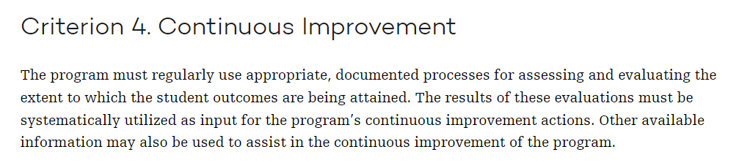
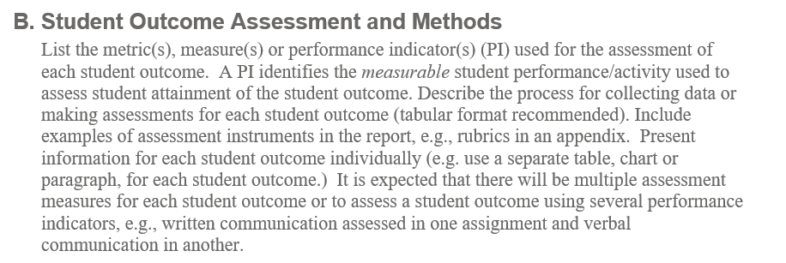
ABET Criterion
This must be read using ABET definitions in mind.
From an ABET Self-Study Template/Guideline
© ABET

Slide 17
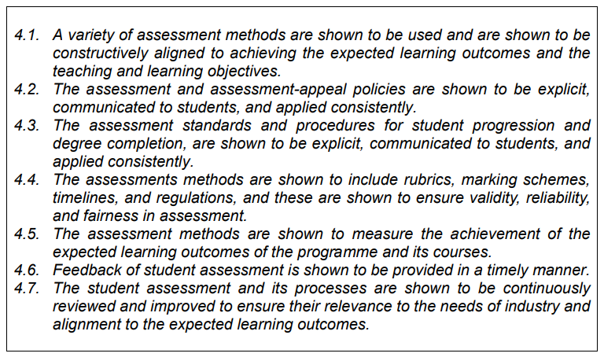
AUN-QA Guidelines
(Program Level 4.0)
Criterion 4. Student Assessment
In my opinion, this criterion uses word “assessment” for both the processes of giving marks (blue highlight) and with determining attainment of program student outcomes (green highlight) or both (yellow highlight).
Vietnamese CEAs base their criteria on AUN-QA criteria
© Scott Danielson

Slide 18




Assessment & Evaluation of Student Outcome Attainment
Developing PIs for each SO
Linking PIs to courses
Creating assessment plan worksheet
Collecting and preparing data
Using relevant & appropriate measures
(maybe) using appropriate sampling methods
Interpreting the data and evidence accumulated through assessment processes
Determining the extent to which student outcomes are being attained.
Making decisions and implement corrective actions regarding program improvement
DATA/EVIDENCE INTERPRETATION
IMPROVEMENT
DECISIONS
AND ACTIONS
ASSESSMENT PLANNING
DATA COLLECTION
ASSESSMENT
EVALUATION
FACULTY INVOLVEMENT
© Scott Danielson & Thai Tran

Slide 19
Program Student Outcome Assessment System Characteristics
Program SO Assessment
Must “probe” all program Student Outcomes (program expected learning outcomes)
Improvement decisions based on context of the program
Not all Performance Indicators are at the same cognitive level
Assessment data taken at the course level but used/evaluated at Performance Indicator and program SO level
Improvement actions may occur in different course from where data taken
Student performance on attaining Student Outcomes based on data from Performance Indicators
Focus assessment activities in last 2 years of program of study
Assessment of SOs does not need to occur in all courses or use all student work—focus the activity to keep it simple and effective.
© Scott Danielson

Slide 20
Course Assessment vs. Program Assessment
This workshop does not focus on course assessment, but the table below lists the similarities and differences between course assessment and program assessment.
Course Assessment & Improvement | Program Assessment & Improvement
Should “probe” all course learning outcomes | Must “probe” all program Student Outcomes (program expected learning outcomes)
Decisions made based on context of course | Decisions made based on context of your program
Not all course learning outcomes are at the same cognitive level | Not all Performance Indicators are at the same cognitive level
Assessment data taken and used at the course level | Assessment data taken at the course level but used at Performance Indicator and program SO level
Improvement actions made in course where data taken | Improvement actions may occur in different course from where data taken
Assumptions related to performance on topics based on performance on concepts | Assumptions related to performance on Student Outcomes based on demonstration of Performance Indicators

Slide 21

Program Student Outcomes

Slide 22
Student Outcomes
Student outcomes (SOs) describe clearly what students will know and be able to do by the time of graduation.
Students have to demonstrate their learning and abilities – ideally via direct evidence.
© Scott Danielson

Slide 23
How Many Program Student Outcomes?
I highly recommend programs establish no more than 8-9 program student outcomes (SOs). In reality, 5 to 7 is sufficient.
This number of SOs is sufficient and allows effective and efficient determination of student attainment of the student outcomes.
© Scott Danielson

Slide 24
Sample Student Outcomes
ABET Example for engineering technology programs
(1) an ability to apply knowledge, techniques, skills and modern tools of mathematics, science, engineering, and technology to solve broadly-defined engineering problems appropriate to the discipline;
(2) an ability to design systems, components, or processes meeting specified needs for broadly-defined engineering problems appropriate to the discipline;
(3) an ability to apply written, oral, and graphical communication in broadly-defined technical and non-technical environments; and an ability to identify and use appropriate technical literature;
(4) an ability to conduct standard tests, measurements, and experiments and to analyze and interpret the results to improve processes; and
(5) an ability to function effectively as a member as well as a leader on technical teams.

Slide 25
Sample Student Outcomes
ABET Example for computing programs
(1) Analyze a complex computing problem and apply principles of computing and other relevant disciplines to identify solutions;
(2) Design, implement, and evaluate a computing-based solution to meet a given set of computing requirements in the context of the program’s discipline;
(3) Communicate effectively in a variety of professional contexts
(4) Recognize professional responsibilities and make informed judgments in computing practice based on legal and ethical principles; and
(5) Function effectively as a member or leader of a team engaged in activities appropriate to the program’s discipline.

Slide 26
Sample Student Outcomes
ABET Example for Applied and Natural Science Programs
(1) Identify, formulate, and solve broadly defined technical or scientific problems by applying knowledge of mathematics and science and/or technical topics to areas relevant to the discipline;
(2) Formulate or design a system, process, procedure or program for the intended purpose;
(3) Develop and conduct experiments or test hypotheses, analyze and interpret data and use scientific judgment to draw conclusions
(4) Communicate effectively with a range of audiences
(5) Function effectively on teams that establish goals, plan tasks, meet deadlines, and analyze risk and uncertainty.
(6) Demonstrate ability to identify ethical and professional responsibilities and the impact of technical and/or scientific solutions in global, economic, environmental, and societal contexts

Slide 27
Course Learning Outcomes (CLOs)
Course learning outcomes (CLOs) describe clearly what students will know and be able to do as part of a course.
Usually students have to demonstrate their learning – which is direct evidence of their work/learning in the course.
© Scott Danielson

Slide 28
Key Principal
Link/connect the program student outcomes and course learning outcomes to measure student attainment of program student outcomes (SOs)
How?
© Scott Danielson

Slide 29
Use Performance Indicators (PIs)!
To EFFICIENTLY determine student attainment of program SOs, we use Performance Indicators and state a metric or target as a standard for success. Link the PIs with course learning outcomes (CLOs)
Performance Indicator: A specific, measurable statement identifying the student performance required to meet the student outcome; confirmable through evidence.
How many? 3-5 per SO
Something lecturer has “control” over the classroom
Observable & measurable
Demonstrated in student work
© Scott Danielson

Slide 30

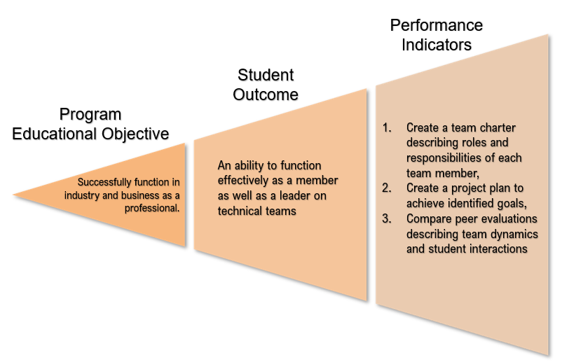

Link the Performance Indicators (PIs) to CLOs
An efficient system links/associates SOs with PIs that link to specific CLOs.
HS202
ME245
ME460
HS308
HS767
ME545
GP606
HS605
Courses in the Program
CLOs for each course
PIs “Link” CLOs and SOs
© Scott Danielson

Slide 31
Program Assessment
Performance Indicators
Student
Outcome
Create a team charter describing roles and responsibilities of each team member,
Create a project plan to achieve identified goals,
Establish leadership roles within a team and monitor team member participation.
Program
Educational Objective
An ability to function effectively as a member as well as a leader on technical teams
Successfully function in industry and business as a professional.
© Scott Danielson
Notes:
The most critical step in creating a valid, meaningful continuous improvement process is to define the anticipated student learning outcomes into a few measurable performance indicators that, when measured, give direct evidence of student learning related to the student outcome. For example, when measuring students’ understanding of working in a team, the program faculty might decide they are going to focus on 3 indicators related to the outcome of “ability to work effectively on a team:”
1) Create a team charter describing roles and responsibilities of each team member,
2) Create a project plan to achieve identified goals,
3) Compare peer evaluations describing team dynamics and student interactions
These three indicators do not encompass all possible concepts and performances that could be measured related to the outcome. However, if the faculty have agreed that these four performance indicators represent the most significant aspects of the outcome for their program, then data can be collected to measure student performance in each of these areas, and the data can be used to provide information on how well the program is enhancing student learning related to the outcome.

Slide 32
Student outcome
Utilize written, oral, and graphical communication in technical and non-technical environments; and identify and use appropriate technical literature.
Performance indicators should clearly address elements of the student outcome.
Written Communication
In technical and non-technical environments
Oral Communication
Graphic Communication
Ability to identify and use appropriate technical literature
© Scott Danielson & Thai Tran

Slide 33
Link the PIs to CLOs
The goal is identify specific CLOs with specific PIs. Each CLOs would have specific examples of student work connected to it.
Usually, lecturers link CLOs to specific student assignments or work. These items of student work, often graded or given marks by the instructor, are where we can gather our direct evidence or assessment data (student performance data).
© Scott Danielson

Slide 34
Writing Performance Indicators (PIs)
PIs should be written so that they link to course learning outcomes (CLOs) in various courses.
For instance, PIs related to teamwork should be able to apply to any course where students work in teams.
Don’t forget Bloom’s Taxonomy and action verbs describing the student learning, behavior or skill
© Scott Danielson

Slide 35
Link the PIs to CLOs
PIs should link to CLOs. But the converse is not true--not all CLOs have to be explicitly linked to an SO or be assessed!
A good PI connects to CLOs in multiple courses.
For example, a teamwork PI can relate to different courses where students practice teamwork.
ME545
ME708
HS202
ME460
SO5: Teamwork
PI5.1: Team Charter with Roles & Responsibilities
PI5.2: Project Plan Development
PI5.3: Peer Evaluation for Team Dynamics & Interaction
ME330
ME245
HS605
GP606
HS308
HS420
HS767
© Scott Danielson & Thai Tran

Slide 36
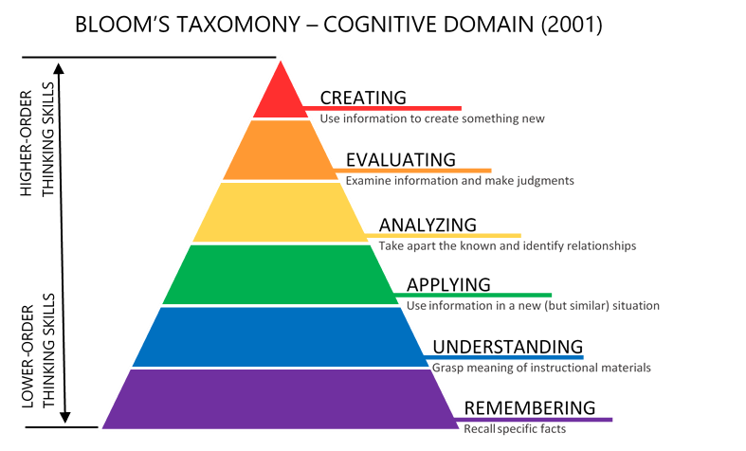
© Scott Danielson & Thai Tran

Slide 37
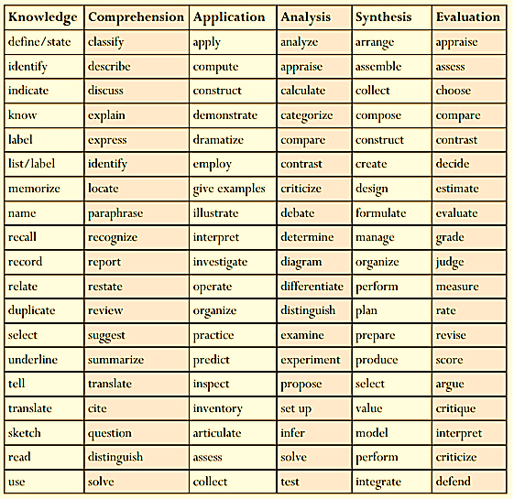
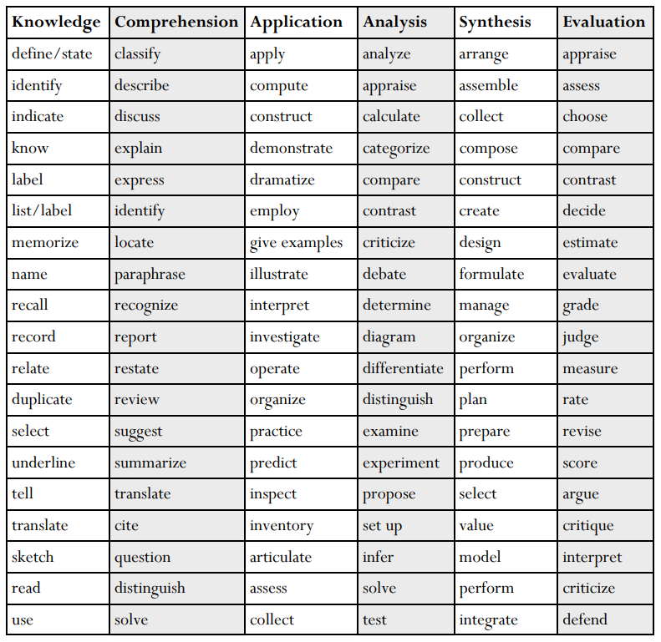
Reminder about Constructing PIs & CLOs
Possible action verbs for Bloom’s cognitive taxonomy levels
It is important to rely on concrete action verbs that specify a specific, observable, student activity
Not passive verbs that are not observable.
Table has possible action verbs related to Bloom’s cognitive taxonomy are listed (from Stanford Univ.)
© Scott Danielson & Thai Tran

Slide 38
Example Performance Indicators (PI)
Possible Performance Indicators:
Students will
Create a team charter describing roles and responsibilities of each team member,
Create a project plan to achieve identified goals,
Reflect on peer evaluations describing team dynamics and student interactions
SO: Function effectively as a member as well as a leader on technical teams
© Scott Danielson

Slide 39
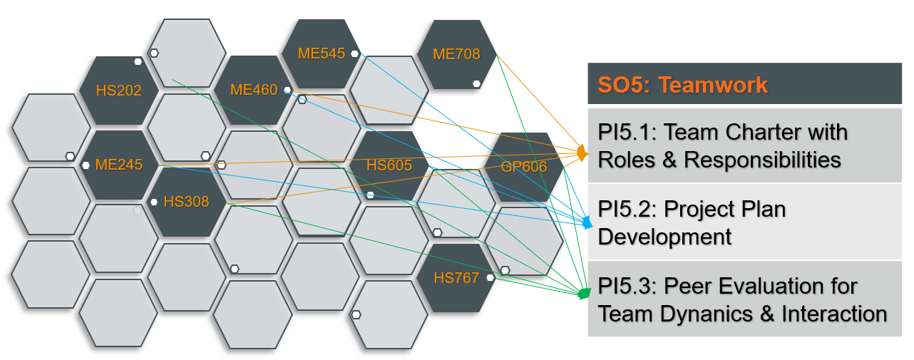
Link the PIs to CLOs
When planning an assessment process, it is good first step to list all the junior or senior courses in your program where these PIs could occur.
Then check to see if that PI can be linked to a CLO shown on the course syllabi (some may, some may not).
Course where the PI is linked to a CLO become the possible place to perform assessment of student attainment of the student outcome.
Written with direct evidence in mind
  Courses with CLO linked to PI - which courses have CLOs that “connect” to the the PI
Starting point
Then pick the best spot for assessment of PI.
SO
PI
CLOs
© Scott Danielson & Thai Tran

Slide 40




Assessment Planning
Once SO, PI and CLO links are established and verified (via course syllabi), PLANNING can begin. The sample planning worksheet shown earlier includes these 1-4 elements
Written with direct evidence in mind
  Courses with CLO linked to PI - which courses have CLOs that “connect” to the the PI
Starting point
Select a course where the PI and a CLO are clearly linked
SO
PI
CLOs
It is the program’s choice to either use or modify the sample table & template.
All elements in the sample worksheet assist the program in their continuous improvement processes.
It is very important to document assessment planning and process!!
© Scott Danielson & Thai Tran

Slide 41

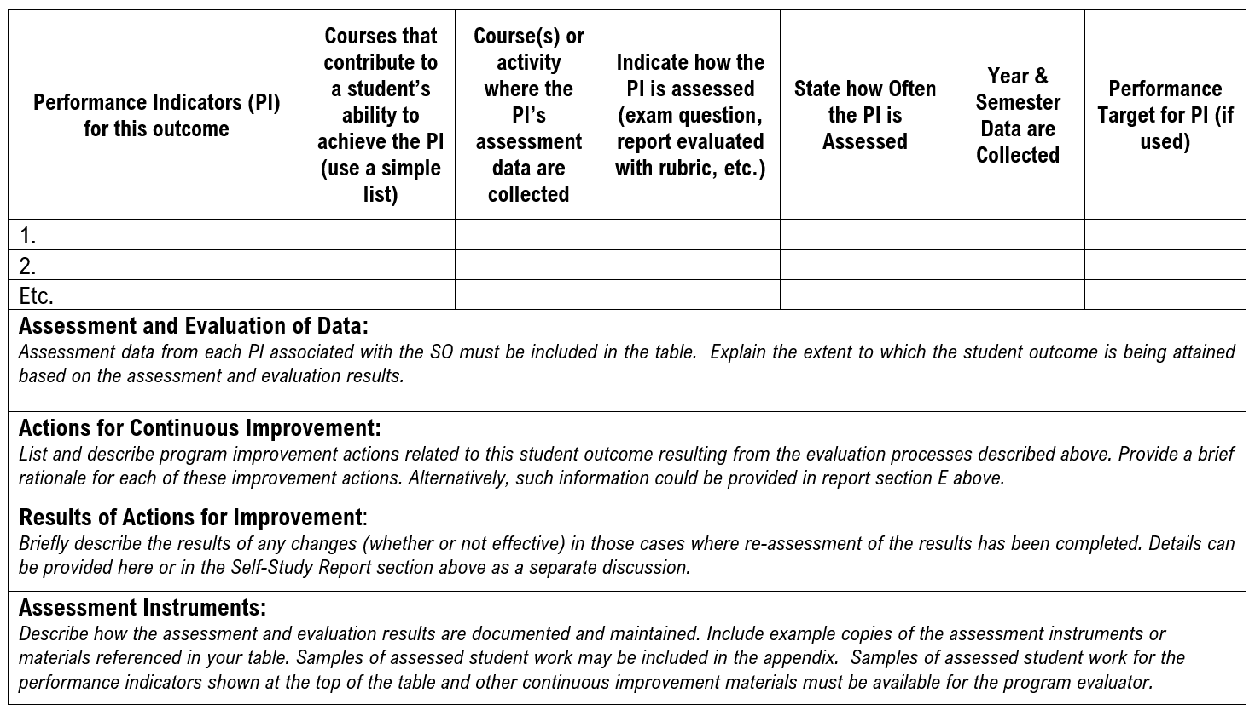


Example Planning Worksheet (Partial)
Student Outcome: An ability to apply knowledge, techniques, skills and modern tools of mathematics, science, engineering, and technology to solve engineering problems appropriate to the discipline
© Scott Danielson & Thai Tran

Slide 42
Example Assessment, Data summary, and Evaluation Worksheet
(Remember ABET Definitions)
ASSESSMENT Planning
Assessment Data & Evaluation
EVALUATION Results
© Scott Danielson & Thai Tran

Slide 43
Example Planning Worksheet (Partial)
Student Outcome: An ability to apply knowledge, techniques, skills and modern tools of mathematics, science, engineering, and technology to solve engineering problems appropriate to the discipline
Performance Indicators (PI) for this outcome (shortened for display here) | Courses that contribute to a student’s ability to achieve the PI (use a simple list) | Course(s) or activity where the PI’s assessment data are collected | Indicate how the PI is assessed (exam question, report evaluated with rubric, etc.) | State how often the PI is assessed | Year & Semester Data are Collected | Performance Target for PI (if used)
1. Exam problem from Mechanics Class | EGR 217 EGR 343 EGR 444 | EGR 343 | Exam Question & Grading Checklist | Every year | Fall, AY2023-2024 | 80% of students get 75% or better
2. Exam problem from Thermo-Fluids Class | EGR 217 EGR 343 EGR 467 | EGR 467 | Exam Question & Grading Checklist | Every Year | Spring, AY2023-2024 | 75% of students get 7 or better on problem
3.Mathematical Modeling in a student project | EGR 465 EGR 466 | EGR 466 | Report, Analytic Rubric | Every Year | Fall, AY2023-2024 | Student attain level 3 or more on rubric
© Scott Danielson

Slide 44
Establishing Timelines
Two-year Data Collection Cycle Across 3rd and 4th year of student cohort spreads work out but allows the 100% coverage of students that is required.
SOs (each with measurable PIs | Cycle 1 |  | Cycle 2 | Cycle 2 | Cycle 3
 | Year 1 | Year 2 | Year 3 | Year 4 | Year 5 | Year 6
SO1 | ● |  | ● |  | ●
SO2 | ● |  | ● |  | ●
SO3 | ● |  | ● |  | ●
SO4 |  | ● |  | ● |  | ●
SO5 |  | ● |  | ● |  | ●
Also demonstrates a “continuous” improvement process.
© Scott Danielson & Thai Tran

Slide 45
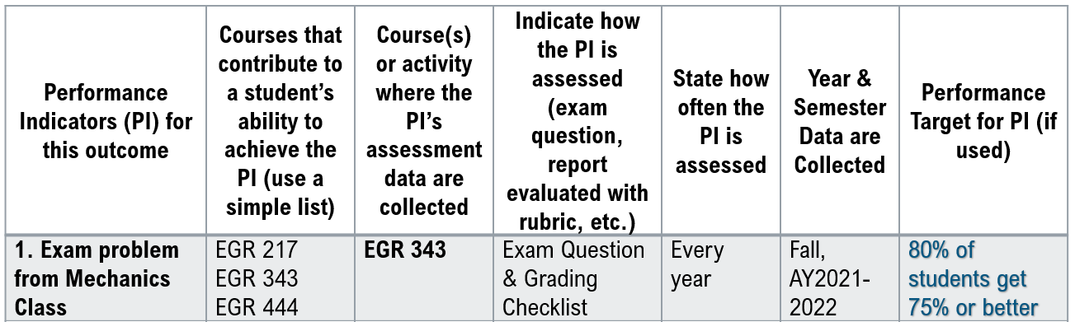
Assessment via Exam Question
For engineering programs, SO1’s PIs are often related to exam problems or a project of some sort.
Many faculty like to use an exam question for assessment data. We will explore in more detail how to do this process.
EGR 444
© Scott Danielson

Slide 46
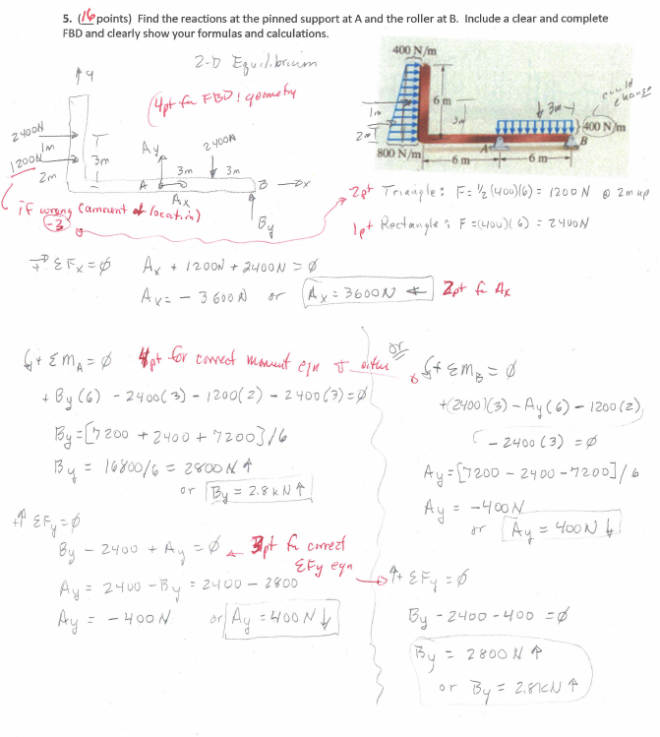
1. Grading Checklist Option
The grading checklist allocates problem points to different parts of lecturer’s solution.
This approach is not as formal as some types of rubrics or grading checklist.
The grading checklist helps ensure more consistent grading of student work across the 60 students in class.
© Scott Danielson

Slide 47
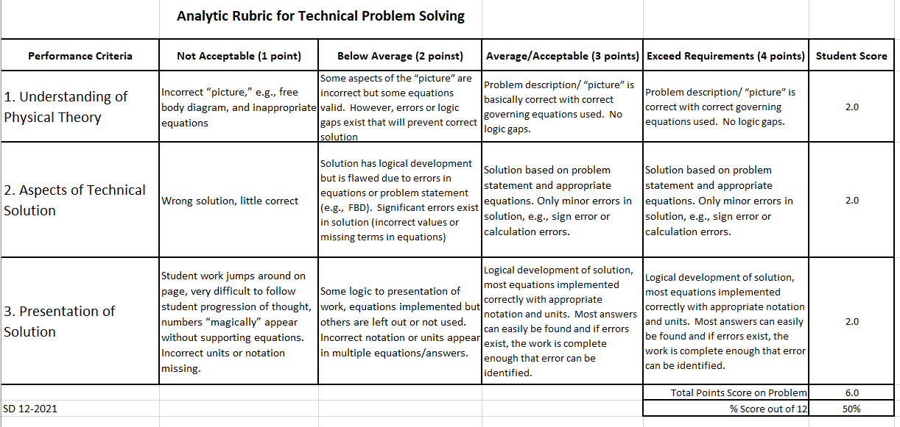
2. Rubric Option
A technical problem rubric was created by Dr. Scott based on suggestion of Vietnamese faculty in a workshop years ago.
This analytic rubric can apply to any engineering problem in engineering mechanics (statics, dynamics, mechanics of materials, etc.)
Point scheme can be adjusted to fit lecturer preferences.
© Scott Danielson

Slide 48
Student Scores
41 students took final
The first column of numbers is the student score on an exam problem.
The second column of numbers is the overall exam score for the exam.
We should record ONE of these score sets as assessment data for our PI.
We transform scores into assessment data using our performance target!
© Scott Danielson

Slide 49
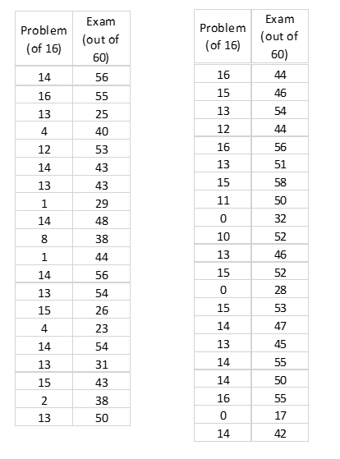
Student Scores
Assessment data results from comparing student scores with a performance target
Target used can be different depending on needs of program
If target is 75% (12 points) or better on the problem, this represents 73% of class (or 31 students) making target.
© Scott Danielson

Slide 50
Student Scores
What if the target is an exam average of 75%, does class meet target?
Average of exam scores is 45 points or 75%, so Yes by averaging.
BUT
75% of 60 = 45 points
# of students ACHIEVED 45 points on problem = 23
# of students did NOT ACHIEVE 45 points = 18
56% of student achieved the target score
Very different result!
DO NOT AVERAGE
© Scott Danielson

Slide 51
Performance Target Summary
There is not a right or wrong on setting performance targets, yet they must be “reasonable.”
Simpler is often viewed as better.
Is it NOT necessary to have all the performance targets be the same for all PIs or SOs.
Avoid averaging when creating assessment data based on grading of student work.
© Scott Danielson

Slide 52
Assessment Methods Wrap-up
VALIDITY
Relevance: The assessment option measures the student outcome as directly as possible.
Accuracy: The option measures the student outcome with confidence that the findings represent the true value of student learning.
Utility: The option provides formative and summative results with clear implications for program evaluation and improvement.
© Scott Danielson

Slide 53
Assessment Methods Wrap-up
BOTTOM LINES
All assessment options have advantages and disadvantages.
“Ideal” methods mean those that are best fit between program needs, satisfactory validity, and affordability (time, effort, and money).
Crucial to use multi-method/multi-source approach to maximize validity and reduce bias of any one approach.
© Scott Danielson

Slide 54
TRIANGULATION
Lab Assignment
Exam Question
Student Projects
Want to
Improve Validity
Triangulation via 3 measurements
Multiple measurements
Different classes, different lectures
© Scott Danielson & Thai Tran

Slide 55
Assessment Methods Wrap-up
Keep in Mind
There will always be more than one way to measure any student outcome.
No single method is good for measuring a wide variety of different student abilities.
It is important to pilot test to see if a method is appropriate for your program.
© Scott Danielson

Slide 56
Evaluation
Evaluation of the assessment data for student outcomes is required by ABET’s Criterion 4.
Evaluation determines how well students are attaining the SOs AS A GROUP.
For ABET, evaluation results of how well students are attaining the SOs must be used as input for continuous improvement actions to comply with Criterion 4.
AUN-QA criteria also encourages a similar process.
© Scott Danielson

Slide 57
What does it mean to “Evaluate”?
Evaluation means interpreting data and evidence accumulated through assessment process.
Evaluation determines the extent to which the student outcome is being attained, e.g., is it meeting the program’s target or goal.
Evaluation provides information on which decisions and actions for program improvement should be based.
© Scott Danielson

Slide 58

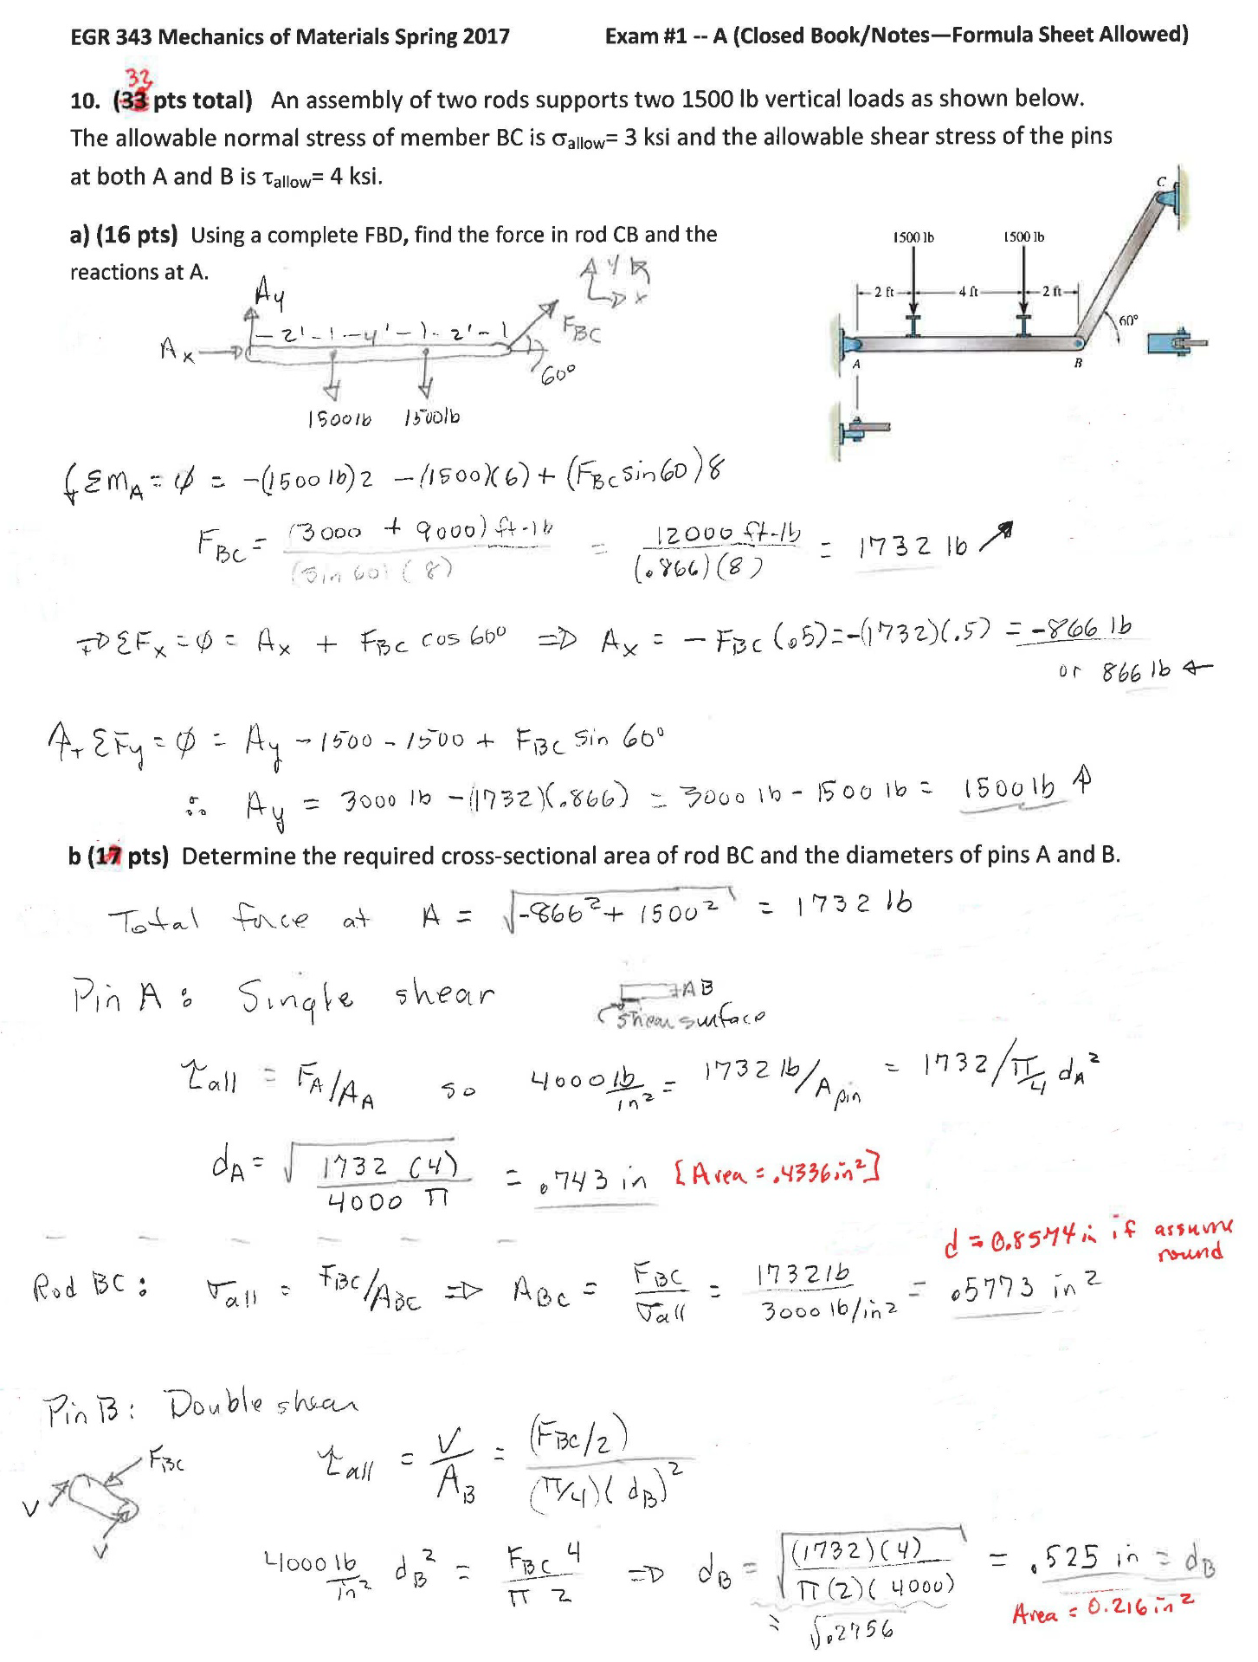
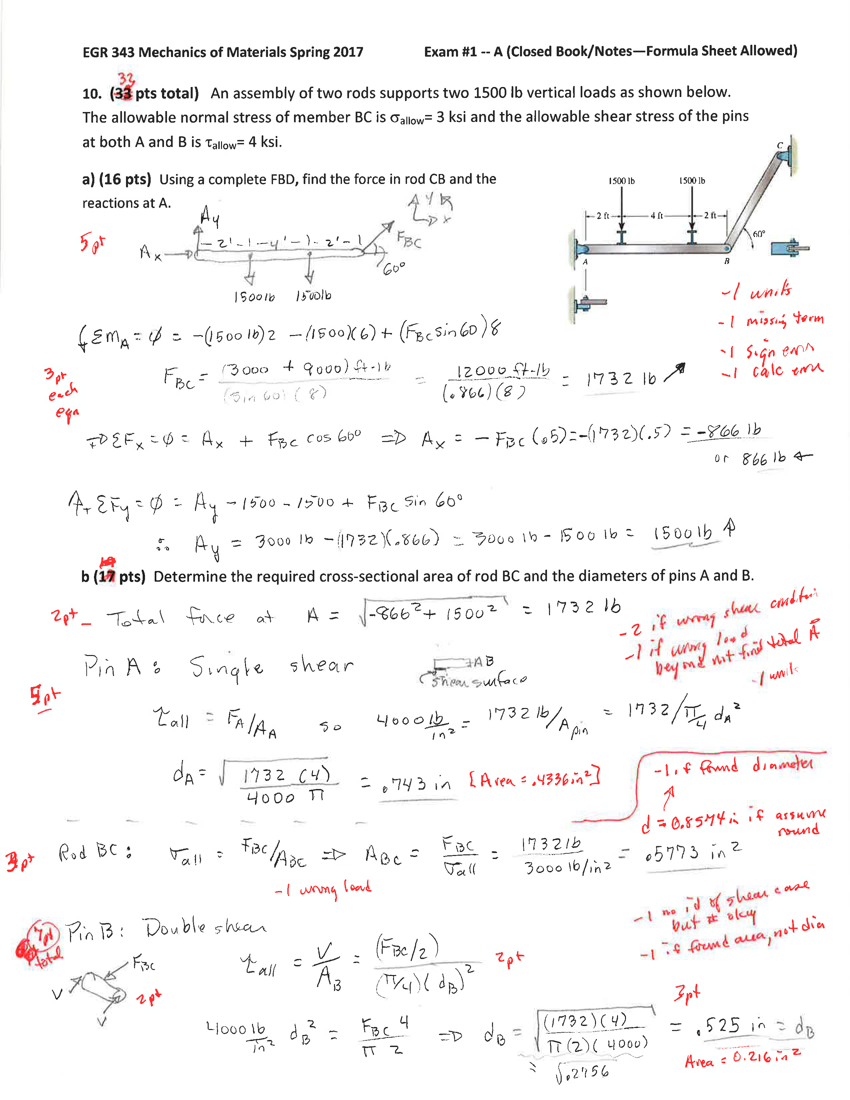
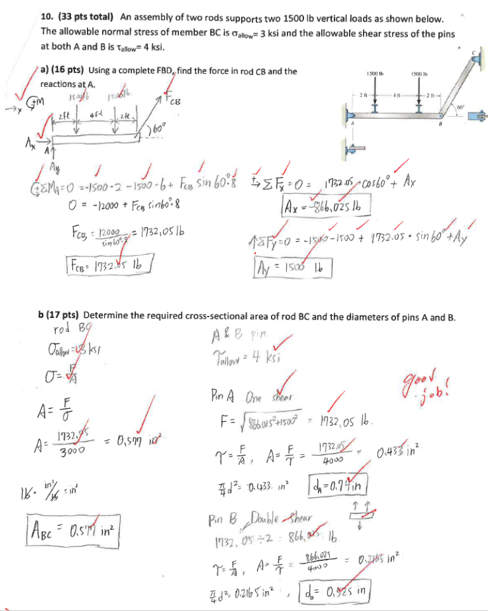
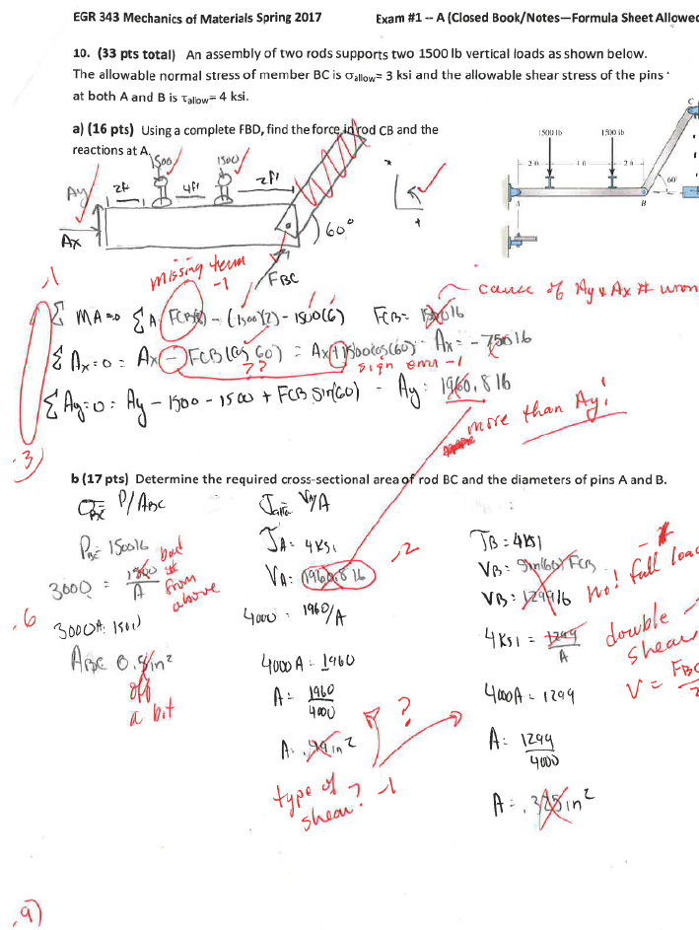
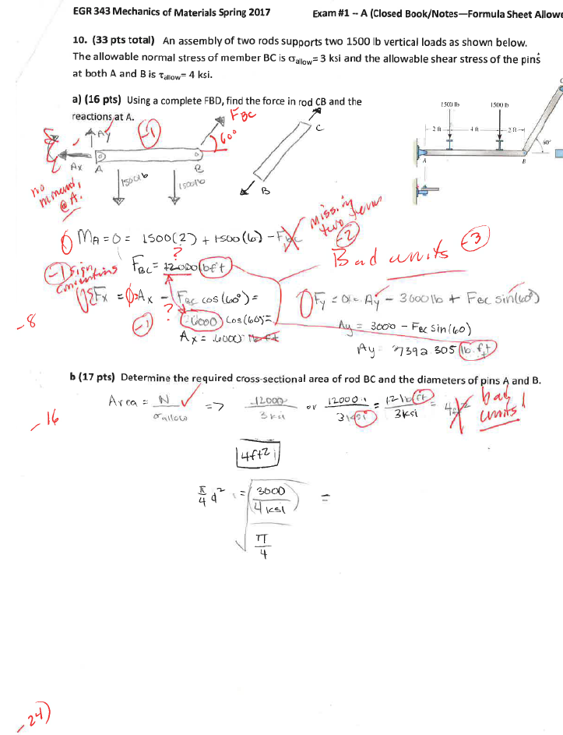
Documentation Submitted by Instructor/Faculty Member
PI Assessment Worksheet
Assessment Method & Measure
Exam Problem
Grading Checklist
Samples of Student Work
Good
Average
Poor
© Scott Danielson & Thai Tran

Slide 59
Faculty Evaluation of Assessment Data
Before overall attainment of an student outcome can be evaluated, there must be a process by which the various data streams from 3-5 different assessment data sets (one data set per Performance Indicator) are combined into a single value representing student attainment of each outcome.
This helps show students have met the SO. It is not required all students meet all PIs, just overall SO.
PI #1 Data Set
PI #2 Data Set
PI #3 Data Set
Aggregate Data Streams
Overall Result for SO1
© Scott Danielson

Slide 60
Aggregated Assessment Data
Student Outcome: An ability to apply knowledge, techniques, skills and modern tools of mathematics, science, engineering, and technology to solve broadly-defined engineering problems appropriate to the discipline
1. Exam problem from Mechanics Class | 30 students achieved 75% or better 11 student achieved less than 75% Summary: 30 out of 41 (73%) met Performance Target
2. Exam problem from Thermo-Fluids Class | 45 students achieved 7 or better on problem 30 student not achieved less than 7 Summary: 45 out of 75 (60%) met Performance Target
3.Mathematical Modeling in a student project | 26 students achieved level 3 or more on rubric 2 student not achieved less than 3 Summary: 26 out of 28 (92.9%) met Performance Target
© Scott Danielson

Slide 61
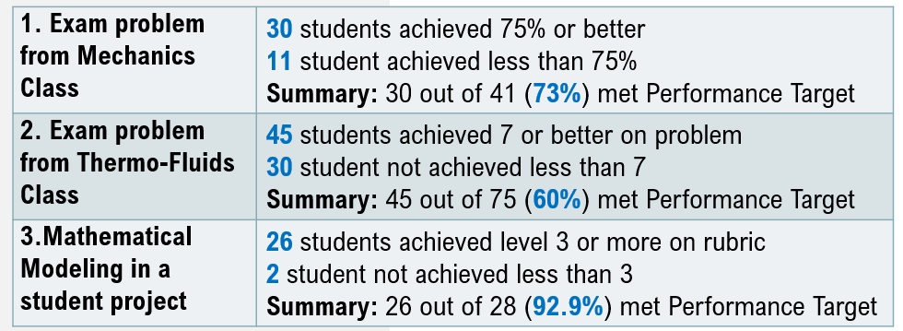



Overall Attainment of SO1
$$SO1 Attainment=\frac{\% PI1+\% PI2+\%PI3}{3}$$
$$=\frac{73\%+60\%+92.9\%}{3}$$
=75.3%
This is bad practice:
average of averages
© Scott Danielson & Thai Tran

Slide 62


Overall Attainment of SO1
$$SO1 Attainment=\frac{Sum of \# of students achieved target from 3 PIs}{Total \# of students from 3 PIs}$$
$$=\frac{30+45+26}{144}$$
Same basic result as weighting process
= 70.1%
Best practice!!!
© Scott Danielson & Thai Tran

Slide 63
Aggregated Assessment Data
Once data are aggregated by SO, those data must be shown in a way that helps the evaluation process.
An effective and simple continuous improvement process focuses on where improvements are most needed (maximize effort where it is most needed).
© Scott Danielson

Slide 64
Evaluation
Assessment is not a controlled experiment.
This is a data-informed, not data-driven process.
Take advantage of faculty wisdom and insight.
Not just anecdotal, but includes human element as well.
Data tell you WHAT
Wisdom tells you WHY
Improvements should be linked to principles of student learning – focus mainly on student learning.
Evaluation = data + wisdom
Data are necessary but not sufficient
© Scott Danielson & Thai Tran

Slide 65
Program Score Card
All Student Outcomes
© Scott Danielson & Thai Tran

Slide 66
Program Score Card—All Student Outcomes
Possible Approach 2 (highly recommended): Targeting the one or two lowest performing student outcomes for improvement activities
© Scott Danielson & Thai Tran
Notes:
When programs begin to focus on a few performance indicators for each student outcome and measure the performance indicators in meaningful (and efficient) ways, the “continuous quality improvement” of student learning will result in meaningful improvement that will be worthy of faculty time and support.

Slide 67
Faculty Evaluation of Assessment Data
The role of the faculty is not over when they help gather and evaluate the assessment data.
Gathering data and evaluating it is of no value if actions for improvement are not taken.
Actions for improvement are key results of the process!!!
Recommend focusing on one or two student outcomes for improvements? How do we choose??
© Scott Danielson

Slide 68
Assessment & Evaluation Process Documentation
1. Assessment Plan
Include assessment plan worksheet that contains:
List of the metric(s), measure(s) or performance indicator(s) (PI) used for the assessment of each student outcome.
Schedule and frequency for each type of assessment as well as points of accountability (tabular format is recommended).
© Scott Danielson & Thai Tran

Slide 69
Assessment & Evaluation Process Documentation
2. Student Outcome Attainment Data
Include data & evidence for each student outcome individually (e.g. use a separate folder for each student outcome.
📂 Student Outcome Attainment Data
  📂 Student Outcome 1
    📄 Assessment Plan
    📂 PI 1.1
      📂 Assessment Instruments (e.g. Problem & Rubric)
      📂 Samples of Assessed Student Work
      📂 PI 1.1 Data Set
      📄 PI 1.1 Attainment Report
    📂 PI 1.2
    📂 PI 1.3
    📄 SO1 Attainment Report
  📂 Student Outcome 2
  📂 Student Outcome 3
  📂 Student Outcome 4
  📂 Student Outcome 5
© Scott Danielson & Thai Tran

Slide 70
Assessment & Evaluation Process Documentation
4. Evaluation & Improvement Actions
Include documents/materials that show:
Summaries of data collected and aggregated evaluation results for the cycle, illustrating current attainment of each SO and trends in attainment over time (tabular or graphical presentation is recommended.)
Documentation of how the results of assessment and evaluation of the attainment of SOs are systematically used as input for the program’s continuous improvement actions.
Evidence of deliberations, decisions, and actions which have been implemented because of the evaluation of student attainment of the SOs.
Evidence might include evaluation reports, agendas, faculty meeting minutes, or memos.
© Scott Danielson & Thai Tran

Slide 71
Key Takeaways
Average of averages of grades are not appropriate assessment data.
Not all assessment data are equal – our emphasis is on direct evidence related to specific PIs.
Assessment results may use percentages but the numbers of students involved in those calculations should be evident.
Assessment data need to be directly connected to program SOs via or through use of CLOs.
Use of PIs and development of related assessment data related to course work already being graded can reduce assessment workload for a program’s faculty.
© Scott Danielson

Slide 72
Cảm ơn
Questions?

